Slide 1
Welcome to Marketing Operations Open Office Hours – September Session

Slide 2
Agenda
Welcome
Keep Marketing Performance Hub (MPH) dashboards accurate: Self-Reported data
Q&A

Slide 3

Marketing Operations Open Office Hours
Get your questions answered by the marketing operations team. Open Office Hours are held monthly with the following agenda:
  Learn about a tip or best practice
  Ask a question – Pre-submit your questions here or ask during the office hours
  Learn how to leverage IQVIA’s marketing systems and processes most effectively
Action: Sign up here, if you need to be added to the outlook invite
Reminder: Save your questions for the end or enter in the chat. We will address as many as we can!

Slide 4
Keep Dashboards Accurate: Self-Reported Data
Srujana Pavuluri
Marketing Operations Open Office Hours September 3, 2025

Slide 5



Where you need to maintain self-reported data
Self-Reported Data Maintained Monthly by Marketing Teams
Reporting Group Organization
IQVIA.com URL Mapping
Event/Webinar Data
Typically driven by organizational change and strategic shifts in campaigns
Reporting groups mapped to new campaigns on submission forms
New reporting group request/changes will be supported in end of monthly process
Smartsheet tool allows marketers to review and add mappings as needed
New web page requests on forms - mapping will be automatic based on marketing selections
Metrics like Registrants, Attendees, Total events/webinars, Total Cost, etc. are all informed from the Event and Webinar calendars. Marketers need to accurately add and update the event and webinar calendars
ON24 webinars and data will come directly from ON24
Link to Change Request Form
Link to URL Mapping Tool
Link to Webinar/Event Toolbox
Notes:
Event and Webinar data is information they should already be providing - we have found that this Is not always the case and there are gaps and suggest team's review.

Slide 6
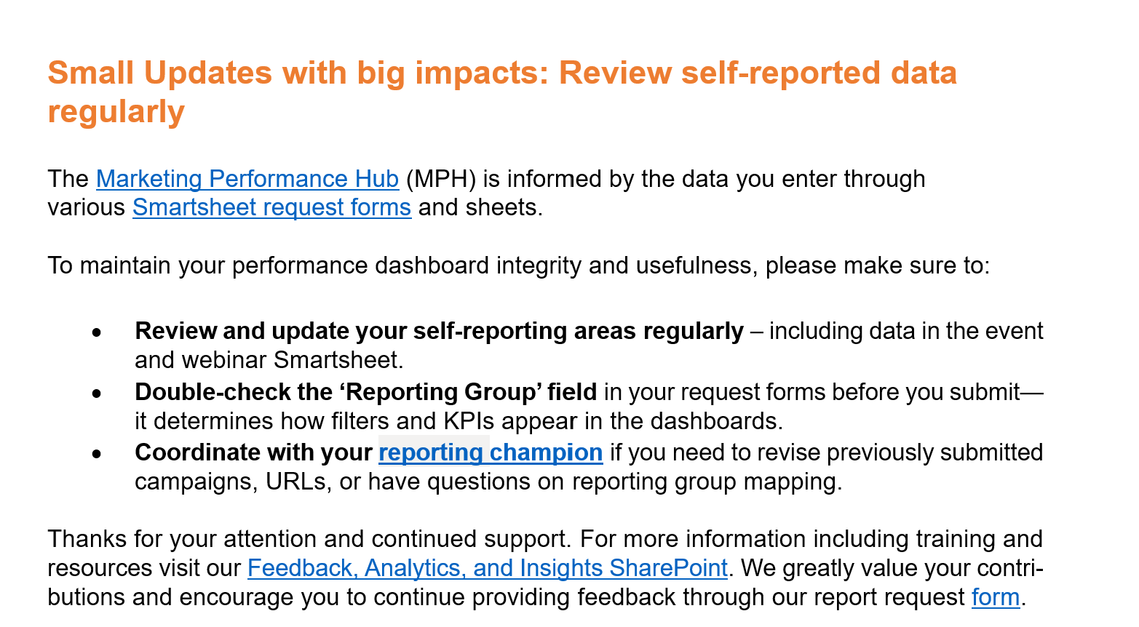
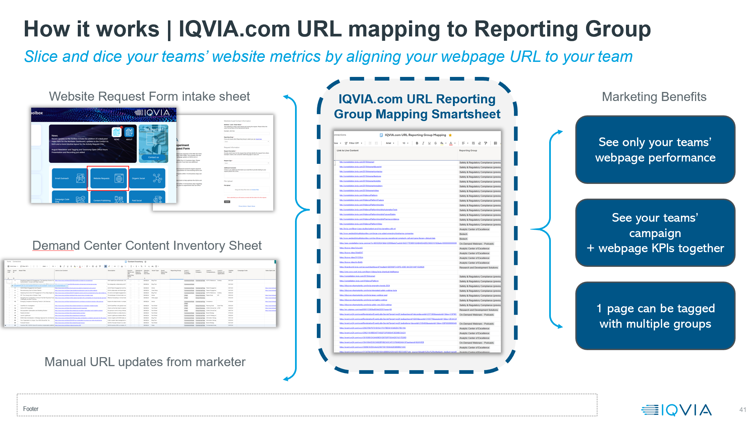
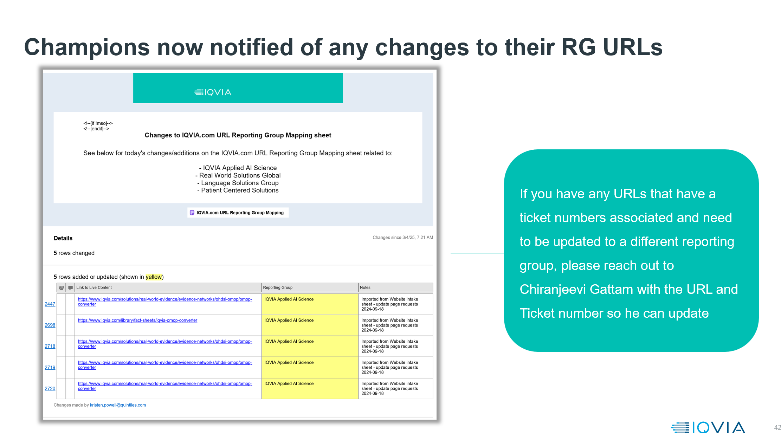
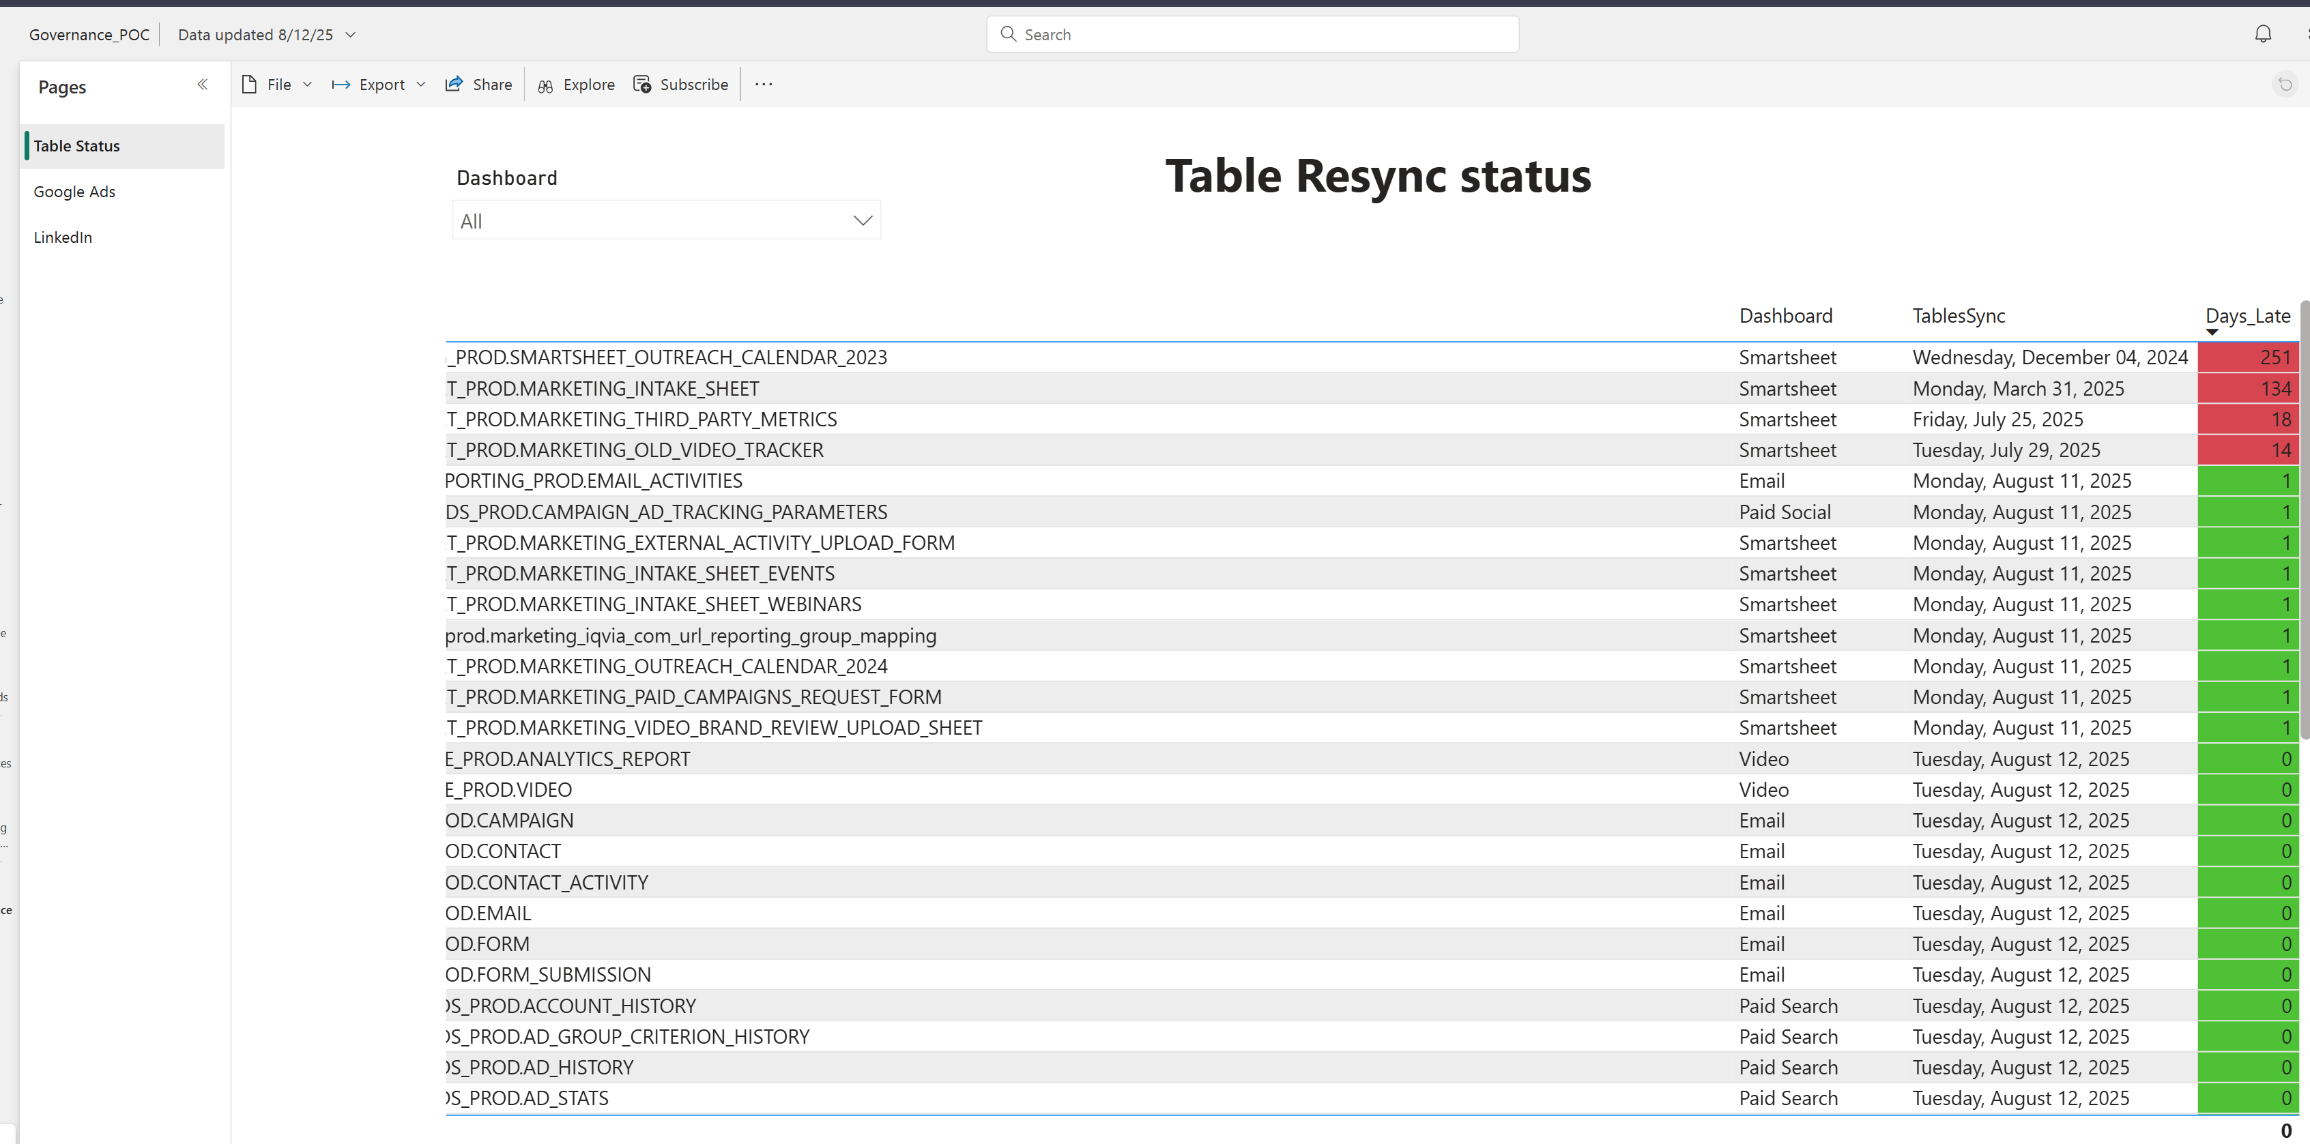
Resources to help improve data quality
Strengthening confidence in data
Newsletter
Monthly reporting champion huddles
Mapping transparency
Alerts
API sync governance dashboard

Slide 7
Thank You

